Slide 1



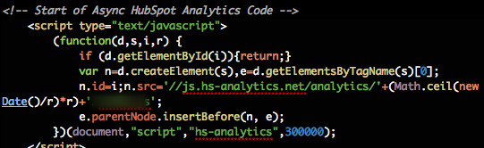
JavaScript OOP
Course Introduction
SoftUni Team
Technical Trainers
Software University
http://softuni.bg

Slide 2


Table of Contents
Course Objectives
Course Program
Trainers Team
Examination
Learning Resources

Slide 3


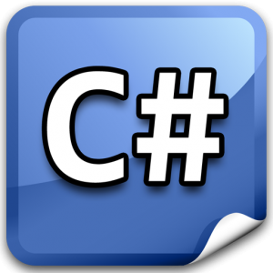
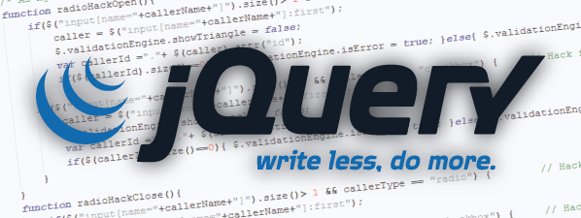

Level #2 at the Software University
Object-Oriented Programming
11 times + TW + exam
6 weeks * 2 times
JavaScript OOP
5 times + exam
3 weeks * 2 times
JavaScript Applications
6 times + TW + exam
4 weeks * 2 times
AngularJS
4 times + project
3 weeks * 2 times
High-Quality Code
16 times + team work project (TW) + Exam
16 weeks * 1 times

Slide 4

JavaScript OOP
Course Objectives & Program

Slide 5


JavaScript OOP – Course Program
Course Introduction – course program, exams, trainers, evaluation, resources
Functions and Function Expressions – advanced functions, IIFE, scopes, closures, modules
OOP in JavaScript – OOP, inheritance, objects, prototypes, function constructor, this, prototype chain, OOP frameworks
JS Design Patterns – module, revealing module, revealing prototype patterns
RequireJS – AMD, RequireJS, defining modules, defining dependent modules
Exception Handling – try-catch, throwing exceptions, custom exceptions
JS Best Practices – naming, scoping, this, variables, strict mode
Exam Preparation
Practical Exam

Slide 6

Warning: Not for Absolute Beginners
The "JavaScript OOP" course is NOT for absolute beginners
Take the "JavaScript Basics" course at SoftUni first: https://softuni.bg/courses/javascript-basics
The course is for beginners, but requires previous coding skills
Requirements
Coding skills – entry level
Computer English – entry level
Logical thinking
coding skills
required!

Slide 7

The Trainers Team

Slide 8
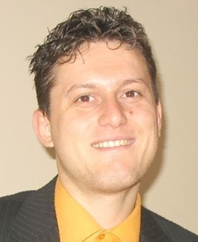
Trainers Team
Svetlin Nakov, PhD
Training & Inspiration Manager @ Software University
20+ years software development experience
10+ years experience as trainer
Author of 7 programming books
Speaker at hundreds of events
Web site & blog: www.nakov.com

Slide 9
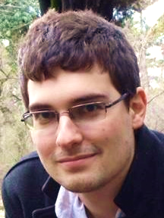
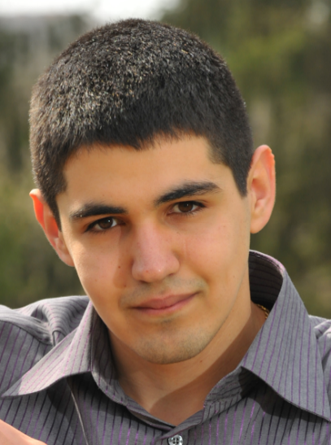
Trainers Team (2)
Teodor Kurtev
Software engineer @ Software University
Top performing graduate from the Software Academy (2013)
Vladimir Georgiev
Software engineer and Trainer @ Software University
Top performing graduate from the Software Academy (2013)

Slide 10
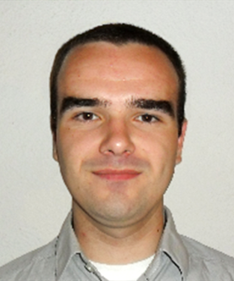

Trainers Team (2)
Vladislav Karamfilov
Game developer @ XS Software
Top performing graduate from the Software Academy (2013)
Volunteer Trainers
Top students from SoftUni
Will teach workshops and advanced topics

Slide 11
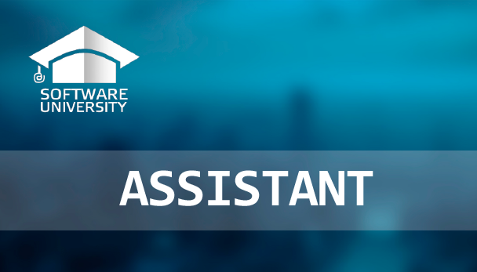
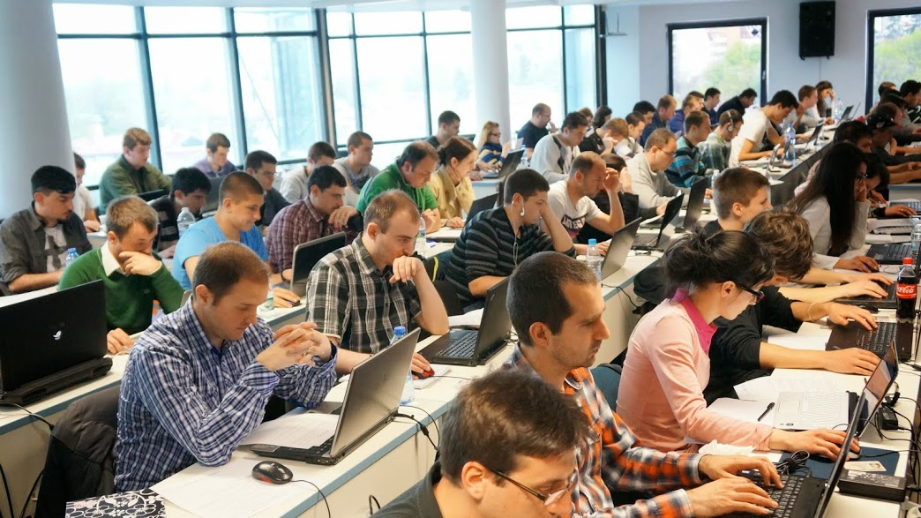
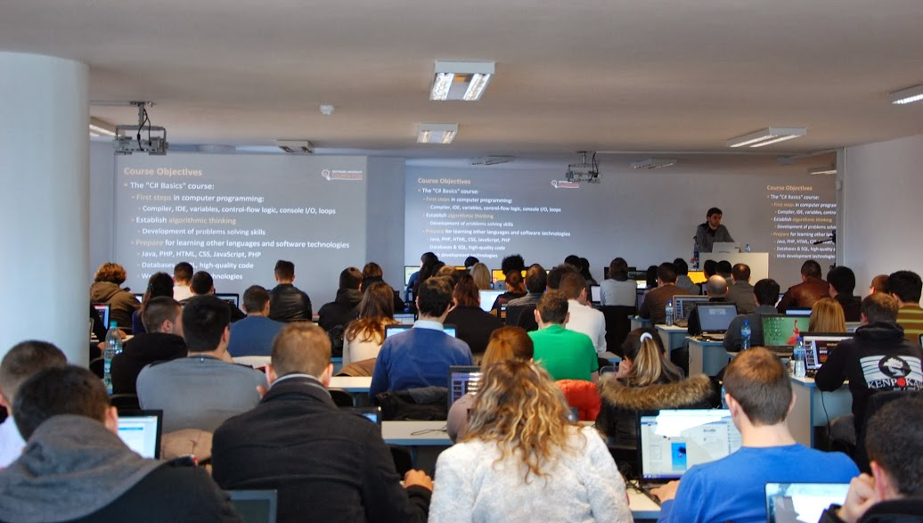
Volunteer Teaching Assistants
10+ volunteer teaching assistants
Developers from the software industry
Scholarship students from SoftUni

Slide 12

JavaScript OOP: More Details
Duration, Languages, Technologies

Slide 13


Training Duration – JavaScript OOP
Lectures: ~ 10 hours (onsite + YouTube videos)
Practical exercises (in class): ~ 10 hours
Homework: ~ 30-50 hours
Team project: ~ 10-20 hours
Exam preparation: 4 hours
Exam: 4 hours
Schedule: Oct-Nov 2014
Exam dates: ~ 12-14 November 2014

Slide 14



Why English?
Why the slides are in English?
English is the native language of the software engineers
Specific terminology should be in English
Translations are inaccurate and funny
Just learn English!
No excuses

Slide 15
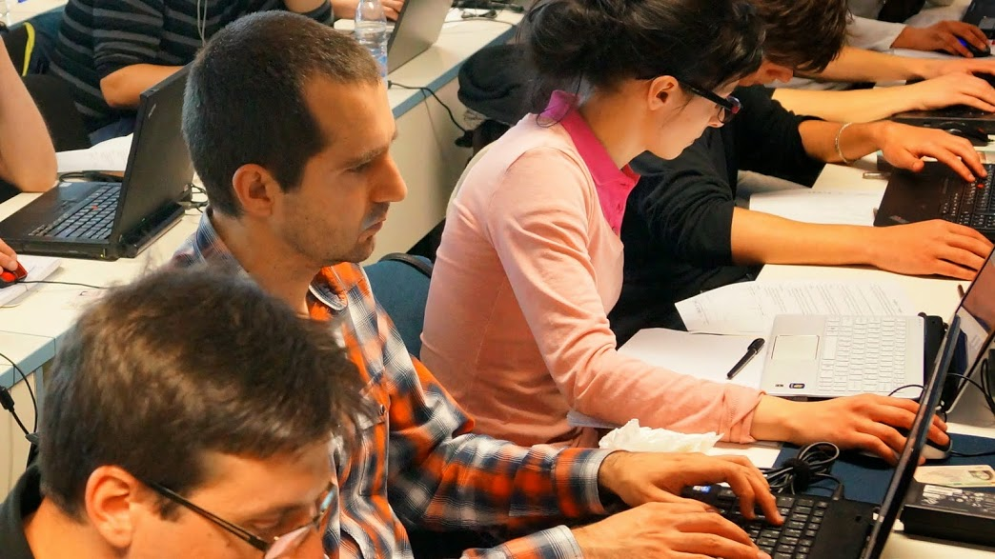


JavaScript OOP
Evaluation Criteria

Slide 16


Scoring System for the “JavaScript OOP”
Exam – 90%
Homework + evaluation – 5% + 5%
Presence in class: 5% (onsite students only)
Bonuses: up to 10%

Slide 17

JavaScript OOP Exam
1 practical problems for 4 hours
You are given a simple project skeleton
Implement the missing functionality properly
Your project should be written in JavaScript
Your project should correctly follow principles of high-quality code
Practical programming exam
Automated judge system gives 50% of the total exam score
The other 50% come from code review by the SoftUni team

Slide 18

Homework Assignments
Doing your homework is very important!
Programming can only be learned through a lot of practice!
You should write code every day!
Each lecture is followed by a few exercises
Try to solve them in class
The rest are your homework
Homework assignments are due in 1-2 weeks after each lecture
Submission will be accepted through our web site: softuni.bg

Slide 19

Homework Peer Reviews
Give feedback to a few random homework submissions
Students submit homework anonymously
Please exclude your name from the submissions!
For each homework submitted
Students evaluate 3 random homeworks
From the same topic, after the deadline
Give written feedback, at least 200 characters
Low-quality feedback → report for punishment
Everyone will get feedback for their homework

Slide 20





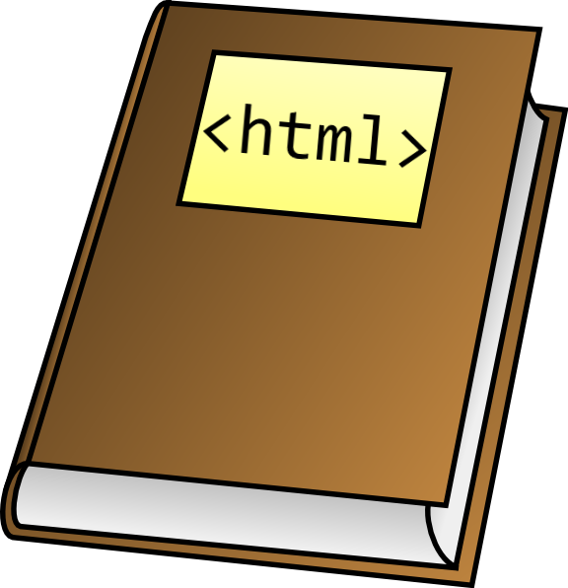



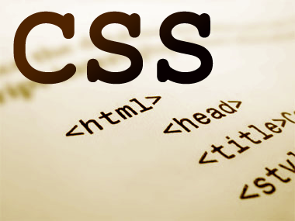
Resources
What We Need Additionally?

Slide 21

Course Web Site & Forums
The JavaScript OOP official web site:
Register for the "Software University Forum":
Discuss the course exercises with your colleagues
Find solutions for all course exercises
Share source code / discuss ideas / help each other
https://softuni.bg/trainings/coursesinstances/details/10
https://softuni.bg/forum

Slide 22



JavaScript OOP Slides and Videos
All lecture slides, videos, homework assignments, projects and other resources are open content, available for free
Visit the course web site to access the course resources

Slide 23




JavaScript Resources
Mozilla Development Network (MDN)
https://developer.mozilla.org
Web Platform
http://www.webplatform.org
JavaScript Books
JavaScript: The Definitive Guide
JavaScript: The Good Parts
JavaScript Patterns

Slide 24
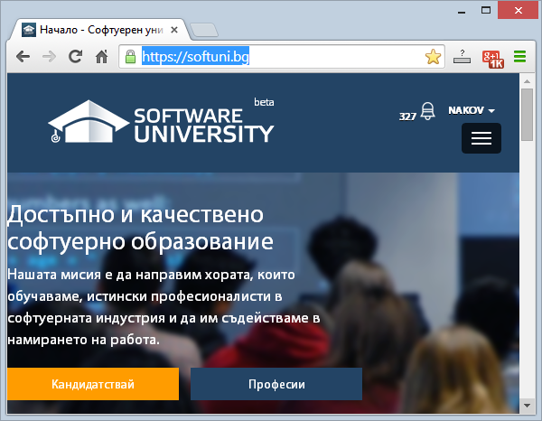
Software University Learning System (SULS)
Software University Learning System (SULS)
www.softuni.bg
Important resource for students
Homework submissions
Homework check-up
Exams and results
Reports about your progress
…

Slide 25


Recommended Software
Microsoft Visual Studio 2013 or Visual Studio Express 2013
WebStorm
Sublime Text
Komodo IDE

Slide 26


Summary
The "JavaScript OOP" course teaches
How to simulate OOP in JavaScript
Training program
Advanced functions, OOP, inheritance, design patterns, RequireJS, best practices
Practical exam
Automated judge system + code review
Learning resources
Lectures, videos, software, books, forum
JS OOP

Slide 27







JavaScript Object-Oriented Programming
https://softuni.bg/courses/javascript-oop/

Slide 28
License
This course (slides, examples, demos, videos, homework, etc.) is licensed under the "Creative Commons Attribution-NonCommercial-ShareAlike 4.0 International" license
Attribution: this work may contain portions from
“JavaScript OOP" course by Telerik Academy under CC-BY-NC-SA license

Slide 29




Free Trainings @ Software University
Software University Foundation – softuni.org
Software University – High-Quality Education, Profession and Job for Software Developers
softuni.bg
Software University @ Facebook
facebook.com/SoftwareUniversity
Software University @ YouTube
youtube.com/SoftwareUniversity
Software University Forums – forum.softuni.bg

